Slide 1
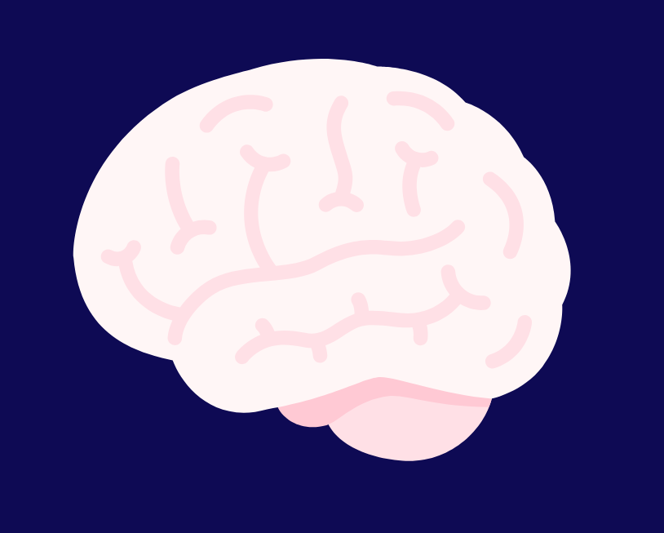








Living in a “Grey Area”: Practices, Attitudes, and Unmet Needs of Patients Without a Dementia Diagnosis.
NoDem
Study
Rowan Souray, Rebecca Atkinson, Daniella Thorn, Elizabeth Ford, and Naji Tabet ​
Background
Methodology
Approximately 1 in 3 people that are referred to memory clinics do not meet criteria for dementia diagnosis.¹ This includes people with:
The NoDem study is a 1-year mixed-method, longitudinal study. We collected questionnaire and medical record data from 387 participants within 6-weeks of a non-dementia diagnosis.
Mild Cognitive Impairment
Functional Cognitive Impairment
Subjective Memory Decline
Age-Associated Memory Loss
No diagnosis
Semi-structured Interviews
Here, we present initial findings from an interview sub-study of 17 participants.
Participants were asked about:
Reasons for referral
Assessment and diagnosis
Support and information
This population has no clear pathway after memory assessment, despite higher dementia risk and evidence that lifestyle changes may help reduce that risk.
Research Aims
Emerging Themes
Understand referral triggers
Understand attitudes, views and hopes
Explore intentions to change lifestyle
Interview data were analysed using NVivo. Given the exploratory nature of this research, open coding and inductive analysis were used to identify data themes.
“Because my own
father had dementia, and you just think, ‘Am I seeing signs that I could now look back
and see that he had?’”
“It would've been
nice to be able to talk to somebody and ask questions.”
Proactivity
& Motivation
Information &
Communication
Participants were proactive, seeking assessments and information to maintain cognitive function and plan for the future.
Participants had difficulties with recall
and understanding due to unclear
communication and being given
complex information.
“If I’d been on my
own, it wouldn’t have been
so good, I would have come away and forgotten
most of it.”
“The letter just said
‘to be kept an eye on’. But as I say, I've heard nothing since.”
The Influence
of Support
Gaps in the
Service Pathway
Participants valued practical and emotional support throughout the assessment
and when implementing
lifestyle changes.
The memory service pathway for non-dementia patients lacked consistency and continuity of support, leaving some participants uncertain about their
next steps.
“You get into a
pattern, when you know what you need to do, but doing it on your own is harder.”
“It’s kind of like, this huge grey area of why am I getting worse?”
Future Directions and Impacts
The NoDem Study findings aim to inform the development of guidelines for health policy relevant to this population. ​
Benefits for Patients & Caregivers
Better quality of life through more appropriate care
Enhanced understanding of non-dementia diagnoses
Improved prognosis due to lifestyle interventions
Benefits for Health Services
Insights into best practice for non-dementia patients
Guidelines for information provision and communication
Improved intervention could lower conversion rates
Contact email : d.thorn@bsms.ac.uk
Funded by:
National Audit of Dementia Memory Assessment Services Spotlight Audit Regional Report 2023/2024. London: Royal College of Psychiatrists. Available from: (rcpsych.ac.uk)
Sponsored by:
Lead site:

